Slide 1
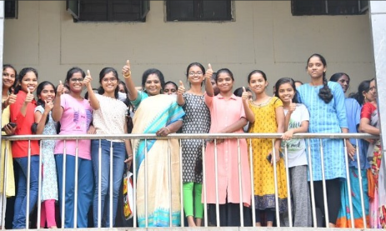
Raj Bhavan Digital Library (Online)

Slide 2
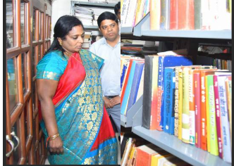
Raj Bhavan Digital Library
Questions to be answered
Can it work 24 x 7 any time and anywhere access -?
Can student use their own digital devices to access including
Laptop, desktop, palmtop, android phones, iphone ?
3. Can Digital material be accessed include books, journals,
documents, videos, links, teaching audio or video files of professors teaching faculty ?
4. Will the cost be high or save time to get copies form books they need ?

Slide 3
Introduction
Reasons why Institutions do not have digital Library
The Library Software is expensive
The cost of digitalisation
Untrained Librarian in digital technologies
Cost involved in hosting servers and maintenance

Slide 4
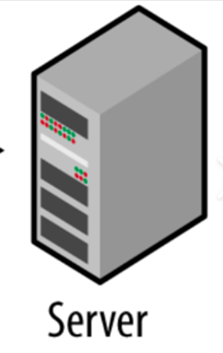
Introduction and Flow Chart
Components of Digital Library our model
Server that connects by internet
On Monthly Rental
Or own server
Digital Library Software
Self created, licenced
Books to be digitalized
Trained Individuals
Server access through domain
www.tsrajbhavandigitallibrary.com

Slide 5
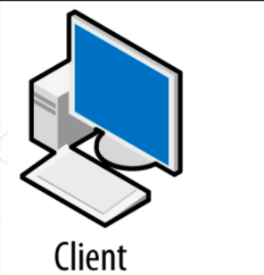
Individual colleges that get
access with separate domain
Raj Bhavan Library

Slide 6
Role of Raj Bhavan
Online Digital Library
Maintenance of server and subscription 1 year
Hosting library software and domain registration
Upload and license for library
Provision of server space for each college and training its librarian
Future app development and new software after six month trial

Slide 7
Cost and Time to set up
Time
One week to ten days time to get license and set up.
SERVER SET UP Raj Bhavan
Server rental 25K per month for three months
Software installation and design Rs 35000
License fees for running URL Rs 30000
One yr. maintenance Rs 5K per month
Web domain charges Rs 300 PM
TOTAL ------------------------------------------------- Rs. 220000 (Rs Two Lakhs Twenty thousand for first three months)
Client set up of individual library for each college
College domain fees Rs 300 PM
Software installation and license fee Rs 30000
Librarian salary, digitalization and books subscription
Installation charges Rs 30000
Maintenance charges Rs 5000 PM
Total : Rs. 125000 ( One Lakh twenty five thousand per yr)

Slide 8
Cost Implication for students
Access anywhere anytime, cost involved is their internet and device cost
2. They can access their book, journals, videos, PPT, PDF, Blogs
and also interact with professors with chat function
3. As library is limited to institution their time to search is easy and they
can take printout from their printer rather than from books or Xerox machines
No waiting in queue for accessing books , no need to depend on
library digital device that is slow in speed
5. The library cost will be as little as Rs 10 to 20 Per month
as subscription fees with option to make it personalised with their professors.

Slide 9
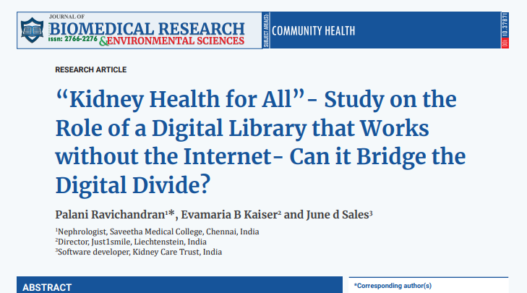
What happens when there is no internet
Digital Divide is modern form of Dalit community
What is the solution to bring a world fifty percent population out of digital divide

Slide 10
Offline digital LIbrary
Server is converted by adding a transmitting wifi device

Slide 11
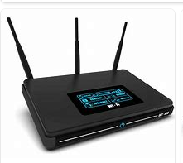
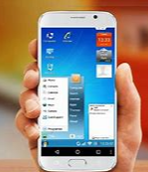
Only individual can connect to
The server with following devices
Raj Bhavan Library

Slide 12
Thank You
Dr P Ravichandran MD DM

